Slide 1
Open Source Unit Testing with IUnit
Wim Jongman, CTO Remain Software

Slide 2
About testing
Acceptance Testing, Accessibility Testing, Active Testing, Agile Testing, Age Testing, Ad-hoc Testing, Alpha Testing, Assertion Testing, API Testing, All-pairs Testing, Automated Testing, Basis Path Testing, Backward Compatibility Testing, Beta Testing, Benchmark Testing, Big Bang Integration Testing, Binary Portability Testing, Boundary Value Testing, Bottom Up Integration Testing, Branch Testing, Breadth Testing, Black box Testing, Code-driven Testing, Compatibility Testing, Comparison Testing, Component Testing, Configuration Testing, Condition Coverage Testing, Compliance Testing, Concurrency Testing, Conformance Testing, Context Driven Testing, Conversion Testing, Decision Coverage Testing, Destructive Testing, Dependency Testing, Dynamic Testing, Domain Testing, Error-Handling Testing, End-to-end Testing, Endurance Testing, Exploratory Testing, Equivalence Partitioning Testing, Fault injection Testing, Formal verification Testing, Functional Testing, Fuzz Testing, Gorilla Testing, Gray Box Testing, Glass box Testing, GUI software Testing, Globalization Testing, Hybrid Integration Testing, Integration Testing, Interface Testing, Install/uninstall Testing, Internationalization Testing, Inter-Systems Testing, Keyword-driven Testing, Load Testing, Localization Testing, Loop Testing, Manual Scripted Testing, Manual-Support Testing, Model-Based Testing, Mutation Testing, Modularity-driven Testing, Non-functional Testing, Negative Testing, Operational Testing, Orthogonal array Testing, Pair Testing, Passive Testing, Parallel Testing, Path Testing, Penetration Testing, Performance Testing, Qualification Testing, Ramp Testing, Regression Testing, Recovery Testing, Requirements Testing, Security Testing, Sanity Testing, Scenario Testing, Scalability Testing, Statement Testing, Static Testing, Stability Testing, Smoke Testing, Storage Testing, Stress Testing, Structural Testing, System Testing, System integration Testing, Top Down Integration Testing, Thread Testing, Upgrade Testing, Unit Testing, User Interface Testing, Usability Testing, Volume Testing, Vulnerability Testing, White box Testing, Workflow Testing.

Slide 3
About Testing
Acceptance Testing, Accessibility Testing, Active Testing, Agile Testing, Age Testing, Ad-hoc Testing, Alpha Testing, Assertion Testing, API Testing, All-pairs Testing, Automated Testing, Basis Path Testing, Backward Compatibility Testing, Beta Testing, Benchmark Testing, Big Bang Integration Testing, Binary Portability Testing, Boundary Value Testing, Bottom Up Integration Testing, Branch Testing, Breadth Testing, Black box Testing, Code-driven Testing, Compatibility Testing, Comparison Testing, Component Testing, Configuration Testing, Condition Coverage Testing, Compliance Testing, Concurrency Testing, Conformance Testing, Context Driven Testing, Conversion Testing, Decision Coverage Testing, Destructive Testing, Dependency Testing, Dynamic Testing, Domain Testing, Error-Handling Testing, End-to-end Testing, Endurance Testing, Exploratory Testing, Equivalence Partitioning Testing, Fault injection Testing, Formal verification Testing, Functional Testing, Fuzz Testing, Gorilla Testing, Gray Box Testing, Glass box Testing, GUI software Testing, Globalization Testing, Hybrid Integration Testing, Integration Testing, Interface Testing, Install/uninstall Testing, Internationalization Testing, Inter-Systems Testing, Keyword-driven Testing, Load Testing, Localization Testing, Loop Testing, Manual Scripted Testing, Manual-Support Testing, Model-Based Testing, Mutation Testing, Modularity-driven Testing, Non-functional Testing, Negative Testing, Operational Testing, Orthogonal array Testing, Pair Testing, Passive Testing, Parallel Testing, Path Testing, Penetration Testing, Performance Testing, Qualification Testing, Ramp Testing, Regression Testing, Recovery Testing, Requirements Testing, Security Testing, Sanity Testing, Scenario Testing, Scalability Testing, Statement Testing, Static Testing, Stability Testing, Smoke Testing, Storage Testing, Stress Testing, Structural Testing, System Testing, System integration Testing, Top Down Integration Testing, Thread Testing, Upgrade Testing, Unit Testing, User Interface Testing, Usability Testing, Volume Testing, Vulnerability Testing, White box Testing, Workflow Testing.

Slide 4
Unit Testing Definition
Unit tests are automated tests written and run by software developers to ensure that a section of an application (known as the "unit") meets its design and behaves as intended.

Slide 5
Unit Testing Definition
In procedural programming, a unit could be an entire program, but it is more commonly an individual function or procedure.

Slide 6
Installing IUnit
putty user@magic.magic-ug.org
git clone https://github.com/i-unit/iunit.git cd iunit source build.sh iunit.restore IUNIT

Slide 7
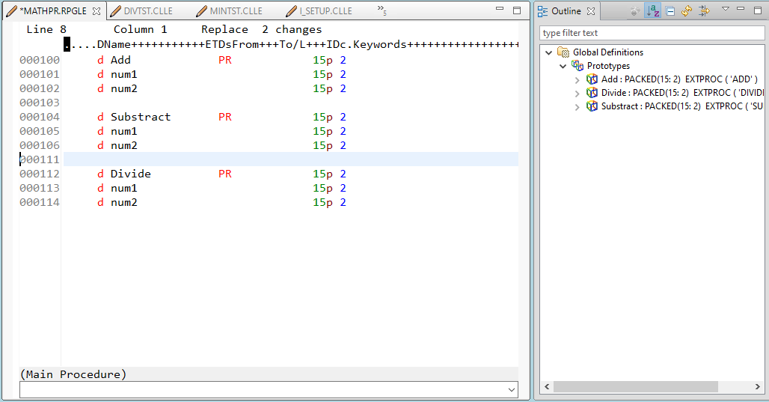
The Test Subject (the unit)

Slide 8
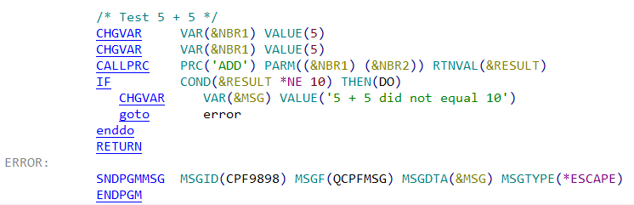
The Test Cases

Slide 9
Run Tests
Let’s run the tests

Slide 10
Test Driven Development
First write tests
Then write code
The proof of the pudding is in the testing

Slide 11
Test Driven Development
Let’s create multiplication

Slide 12
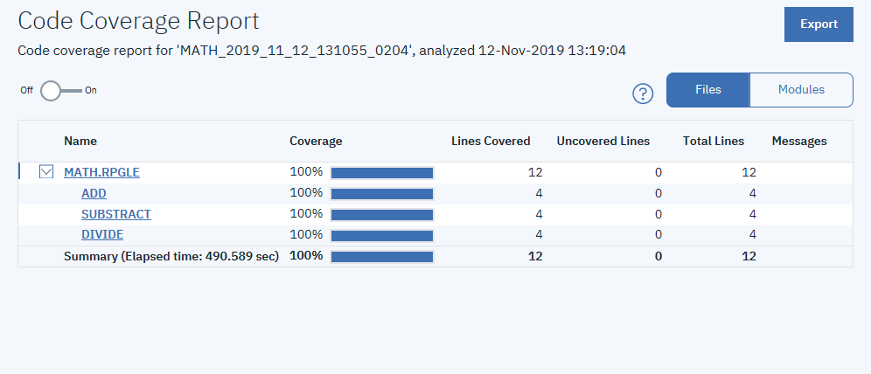
Code Coverage

Slide 13
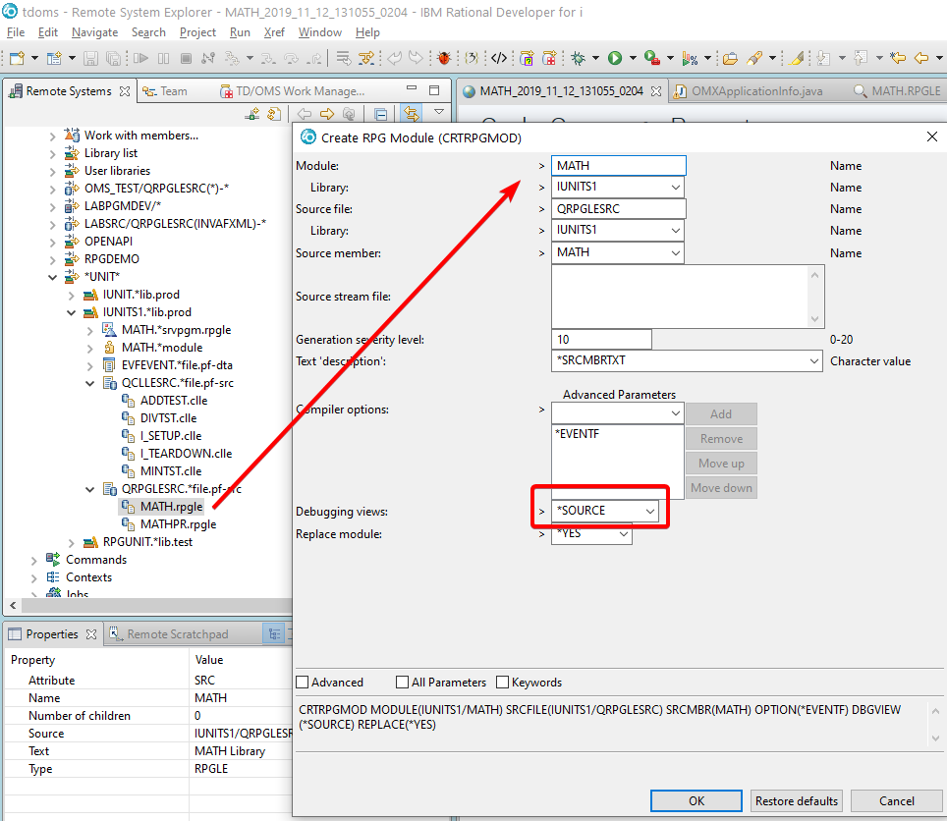
Code Coverage
Make sure to compile with *SOURCE

Slide 14
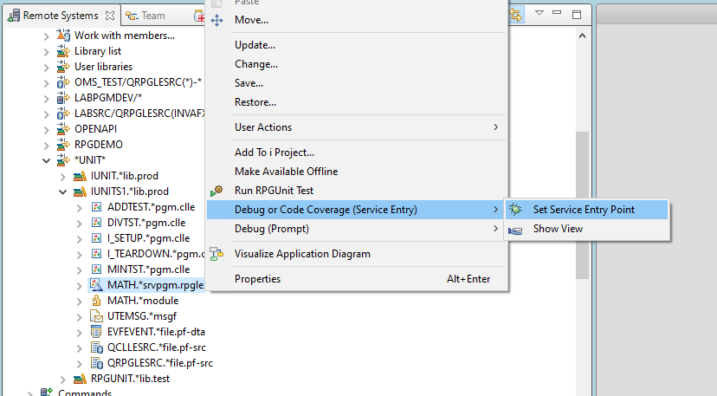
Code Coverage
Set the SEP on the service program

Slide 15
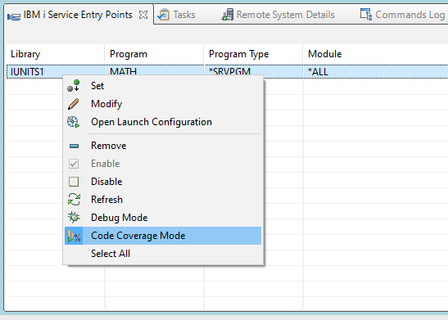
Code Coverage
Switch to Code Coverage Mode

Slide 16
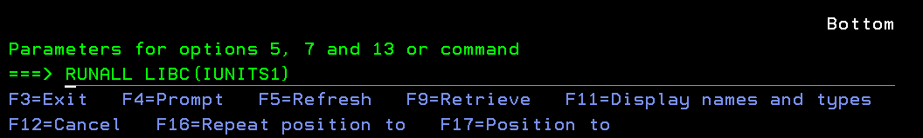
Code Coverage
Run the Code

Slide 17
Code Coverage

Slide 18
Questions?

